Slide 1
Computer and Network Architecture
IS 201
Notes:
http://gaskination.com/ticker
http://www.worldometers.info/
http://www.internetlivestats.com/
http://wwwnui.akamai.com/gnet/globe/index.html

Slide 2
Announcements
Digital Dialog set up – Discussions for each chapter.
Pitch in and answer your peer’s questions.
TA’s will also monitor and respond.
Office Hours will be Virtual using Google Hangouts or Phone
Watch Learning Suite for times and Hangouts Link
Slides posted within 24 hours of class (“Master”, unedited slides are available in MyEducator)
“How Was Class?” Survey

Slide 3

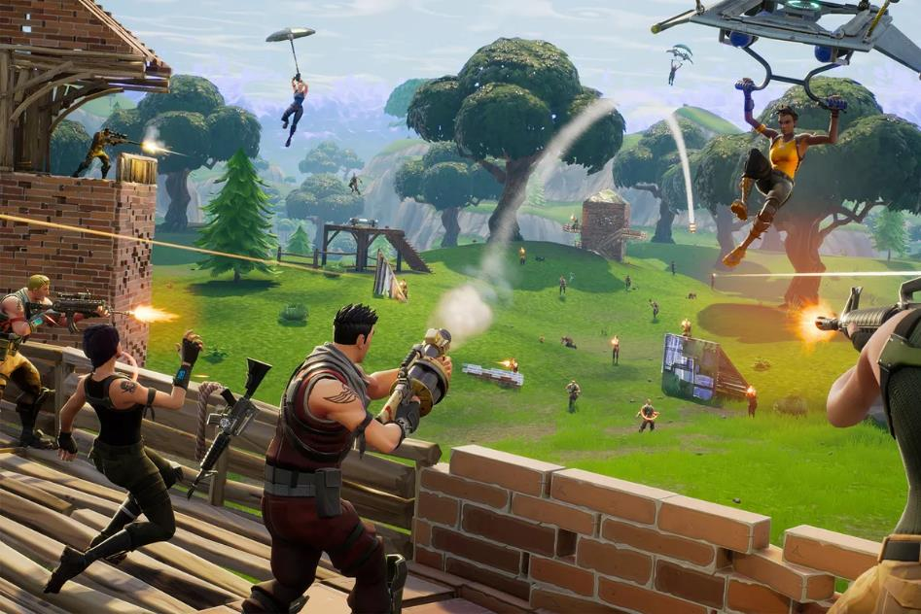
Every player is just zeros and ones

Slide 4



Why Binary?
0000 = 0
0001 = 1
0010 = 2
0011 = 3
0100 = 4
0101 = 5
0110 = 6
0111 = 7
1000 = 8
1001 = 9
1010 = 10 (Hex A)
1011 = 11 (Hex B)
1100 = 12 (Hex C)
1101 = 13 (Hex D)
1110 = 14 (Hex E)
1111 = 15 (Hex F)

Slide 5
Things more complex than integers
Colors, Images
Pixel color: #3f78ac
Binary: 0111111 01111000 10101100
Red: 3F = 63/255
Green: 78 = 120/255
Blue: AC = 172
24-bits per pixel yields 16,777,216 possible colors.
1920 x 1080 HD image = 2,073,600 pixels
Alphabet (in ASCII)
a = 01100001
b = 01100010
c = 01100011
d = 01100100
e = 01100101
f = 01100110
g = 01100111
h = 01101000

Slide 6
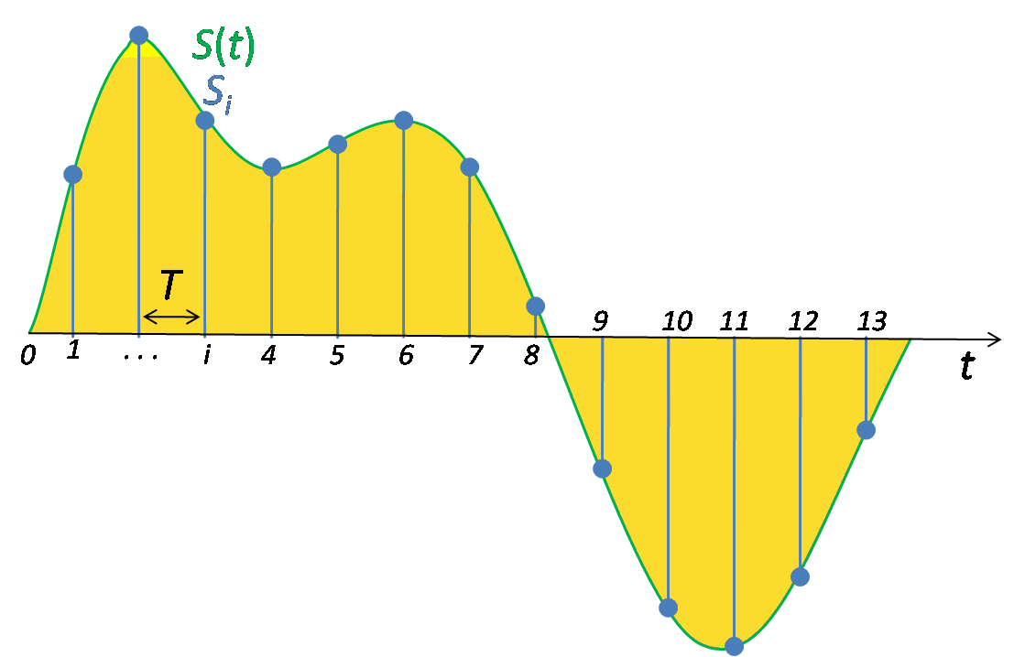
Sound
CD quality sound: 44,100 samples/second, 16-bit samples (yielding 65,536 levels per sample)
Notes:
Nyquist theorem: Samples must be twice as frequent as the highest rendered frequency. 42Khz is at the limit of human hearing.

Slide 7
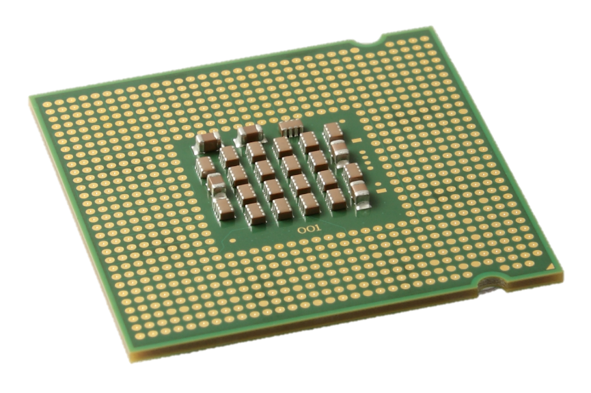
A Central Processing Unit (CPU) is a Finite State Machine
Outputs
Digital Logic
Current State
1
0
0
1
1
0
1
0
0
1
0
1
Clock
Next State
1
0
0
1
1
0
1
0
0
1
0
1
Inputs
Digital Logic

Slide 8




Digital Logic
AND
OR
NAND
NOR
Truth Table

Slide 9
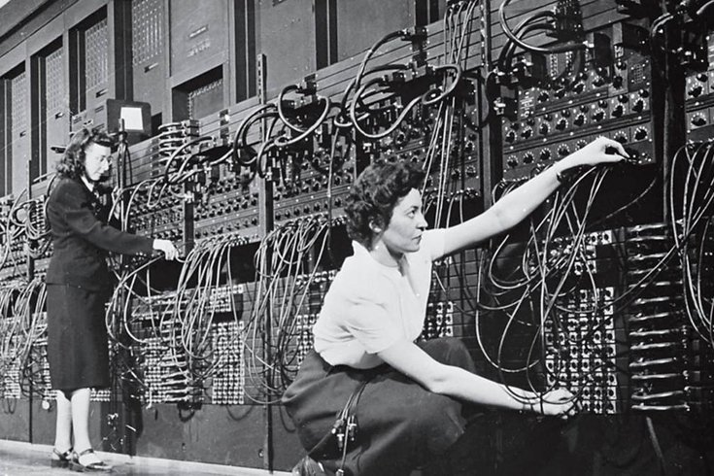
The First Programmers
1946: Women programming the ENIAC computer.

Slide 10
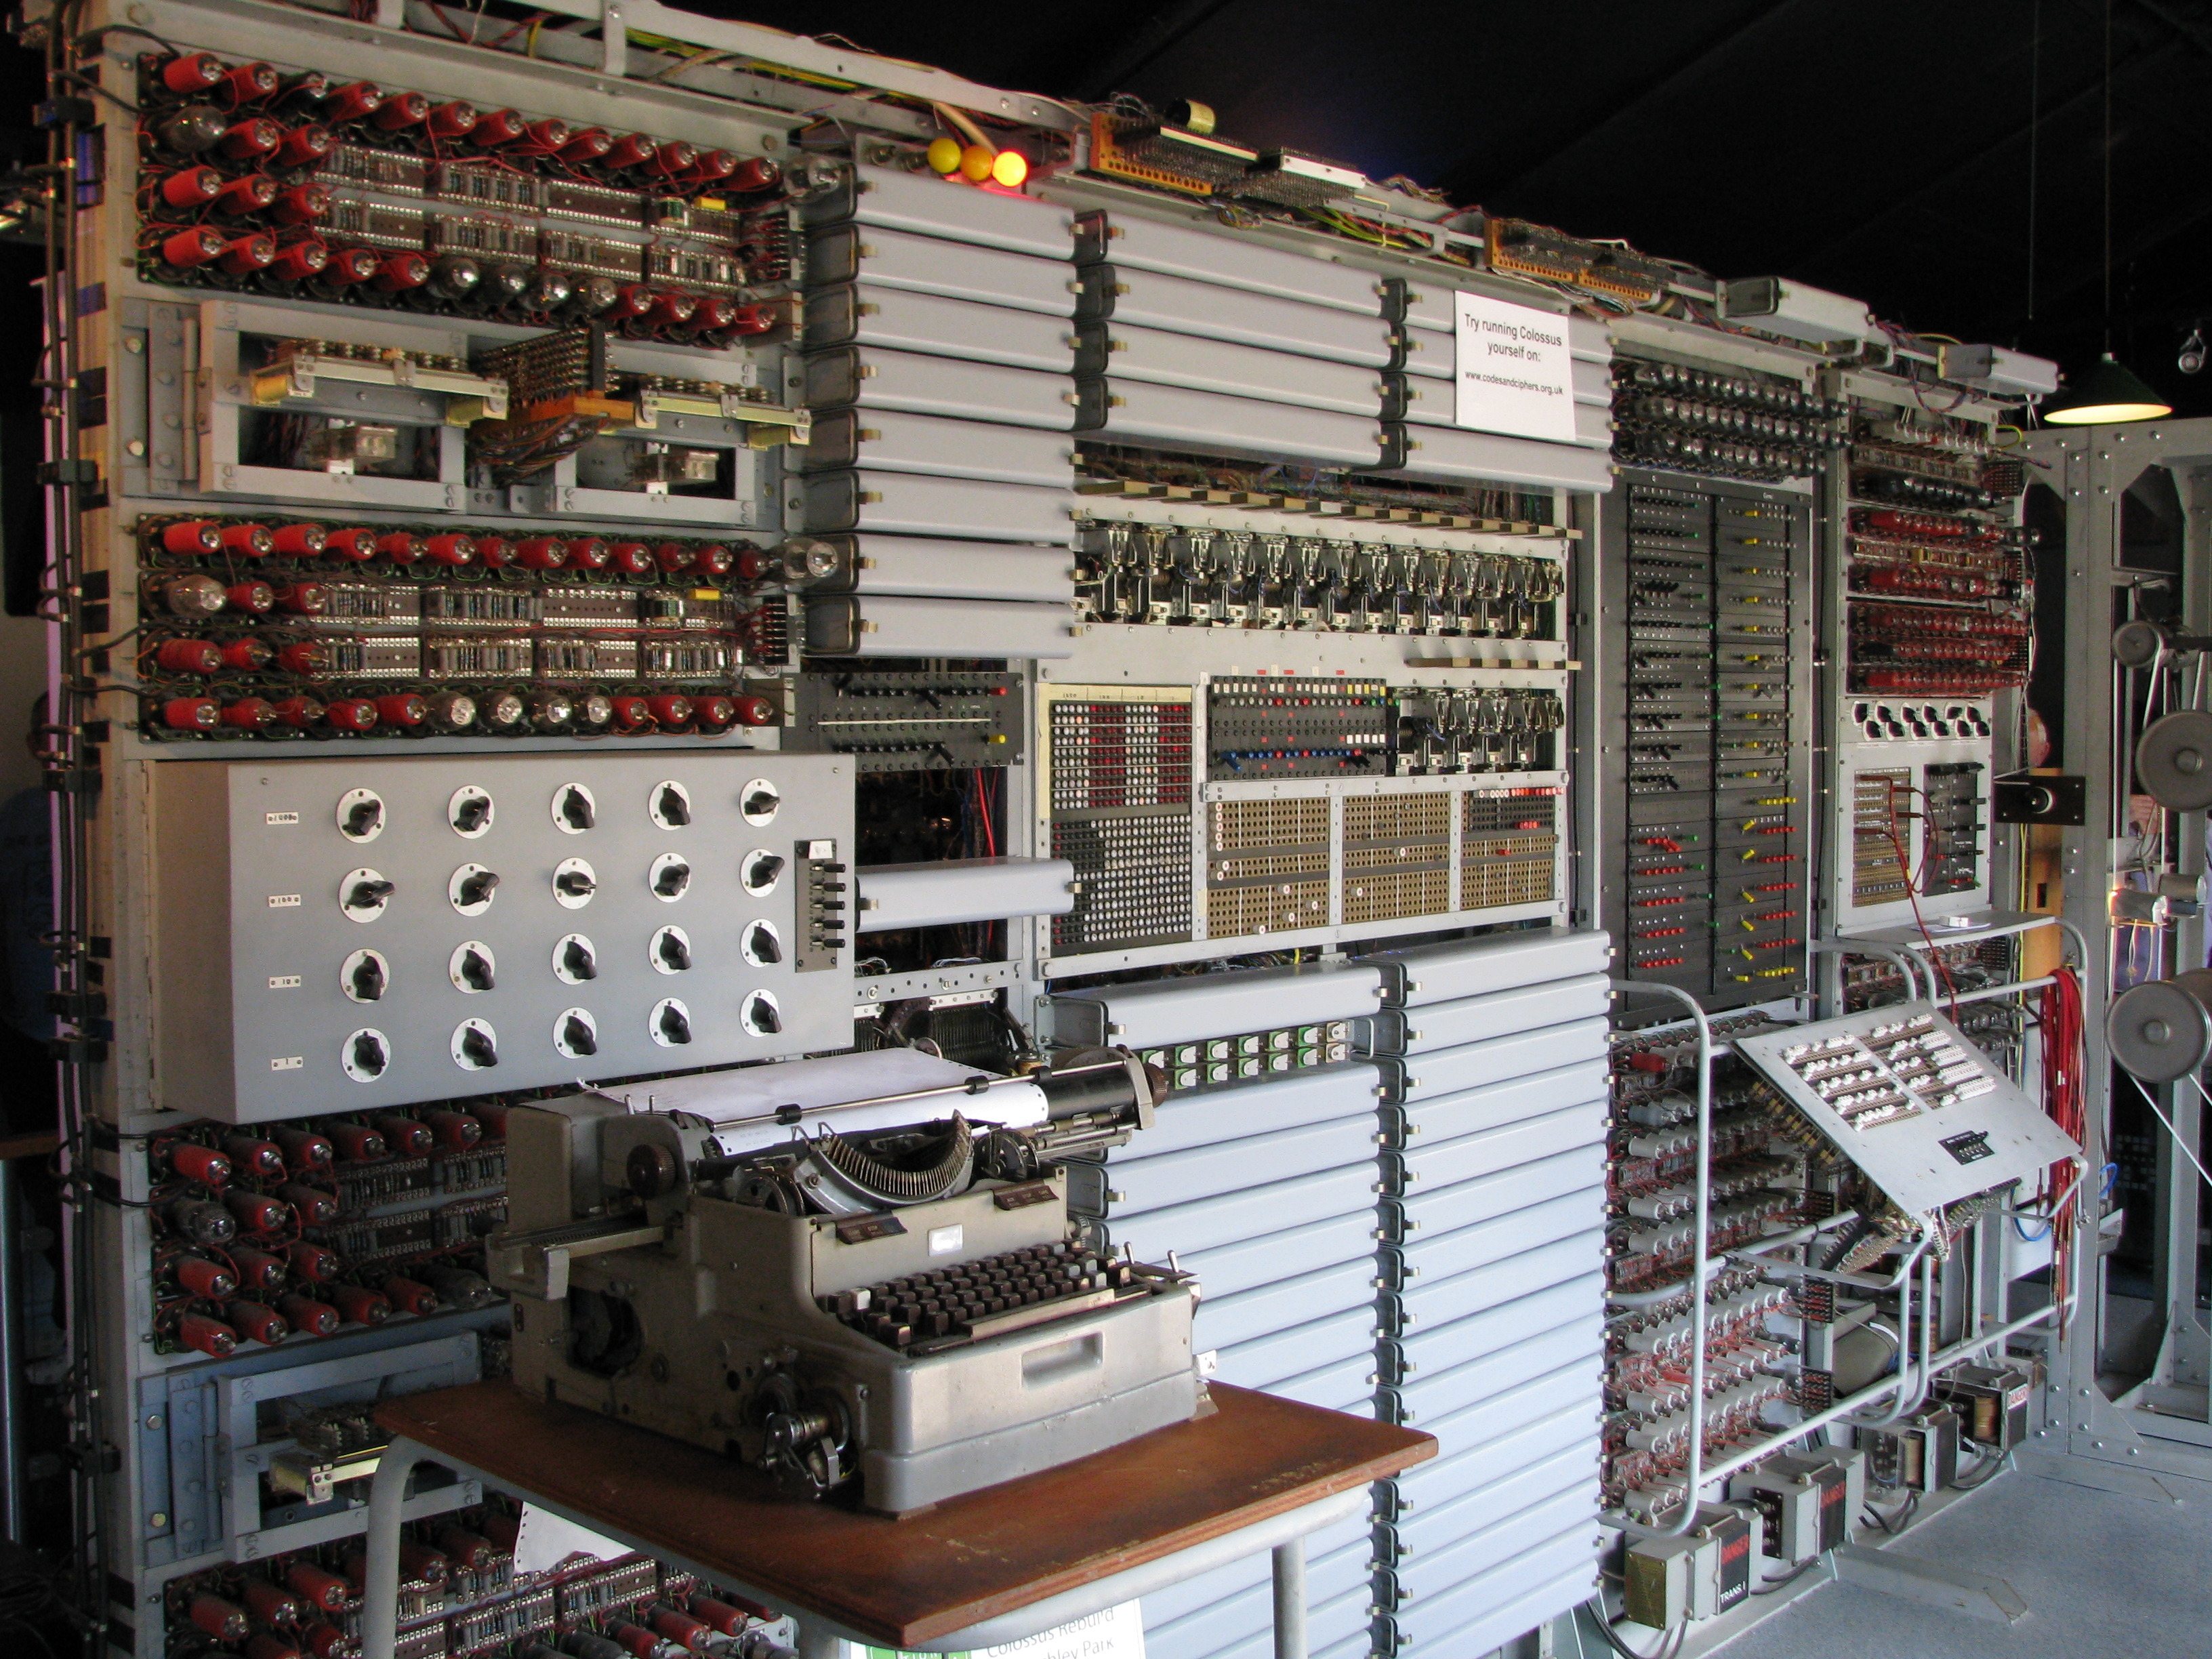
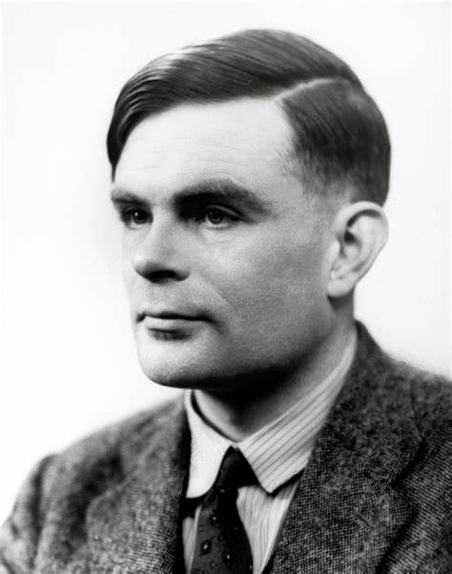
Colossus Replica at Bletchley Park
Alan Turing

Slide 11
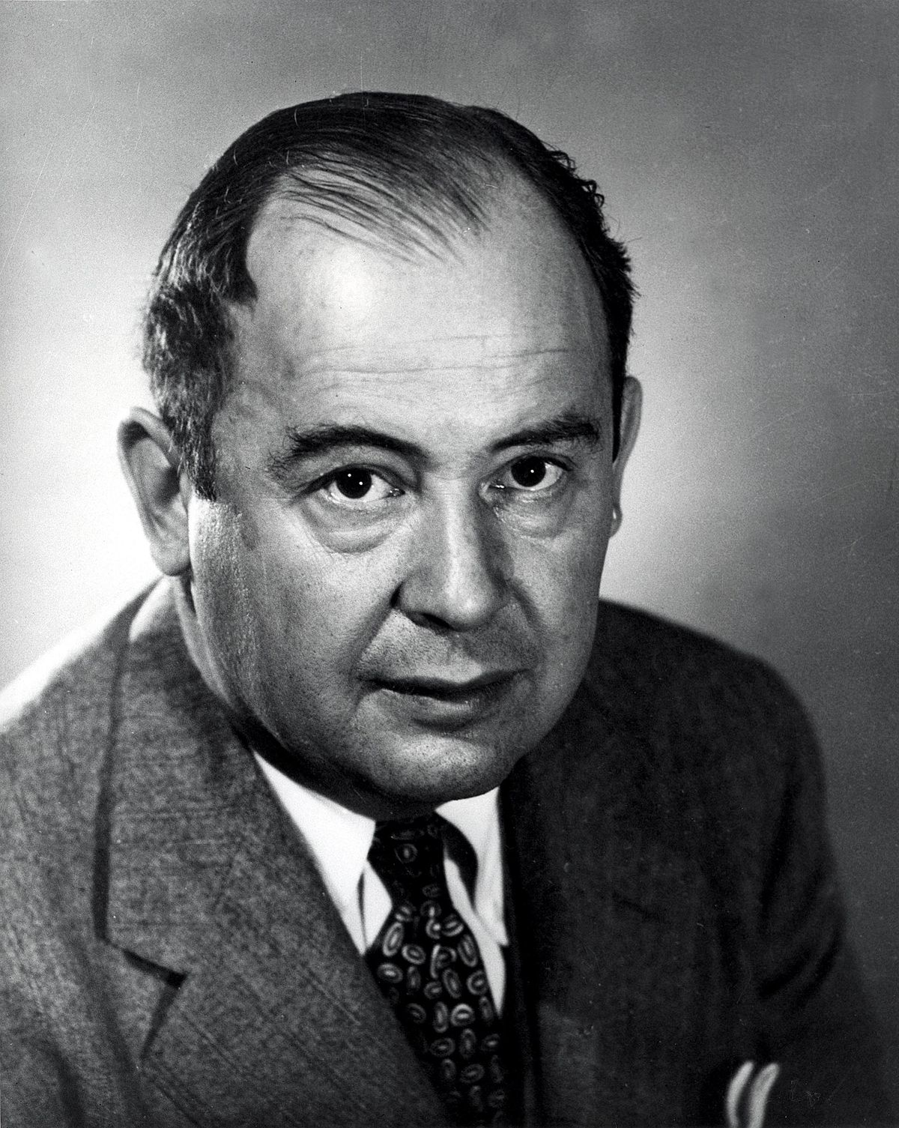
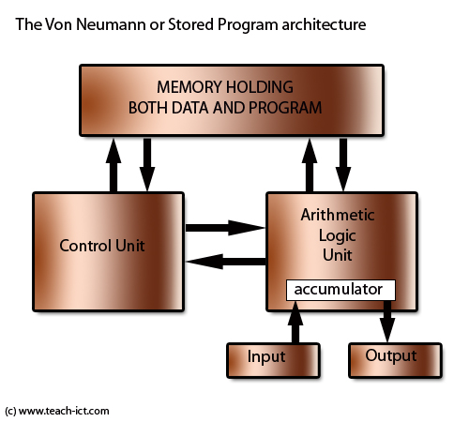
John Von Neumann

Slide 12
Central Processing Unit (CPU)
What are my current specs?
PC:
right-click This PC -> Properties
Mac:
click Apple button -> About This Mac
Right-click HD icon on desktop -> Get Info
http://www.cpubenchmark.net/
Velocity.ninja (together as a class)

Slide 13
Central Processing Unit (CPU) Performance PassMark – a general overall kind of test
CPU Model | Clock (GHz) | Cores | Threads | Cache (MB) | PassMark Benchmark | Energy | Cost
i7-6950X | 4.0 | 10 | 20 | 25 | 19,994 | 140 W | $1635
i7-6900K | 4.0 | 8 | 16 | 20 | 17,654 | 140 W | $1044
i7-6850K | 4.0 | 6 | 12 | 15 | 14,491 | 140 W | $588
i5-6600K | 3.5 | 4 | 4 | 6 | 7,931 | 91 W | $240
i5-6500 | 3.2 | 4 | 4 | 6 | 7,137 | 65 W | $199
i3-6100 | 3.7 | 2 | 4 | 3 | 5,445 | 51 W | $117
i3-4170 | 3.7 | 2 | 4 | 3 | 5,144 | 54 W | $118
BEST CURRENT CPUs: http://www.futuremark.com/hardware/cpu

Slide 14
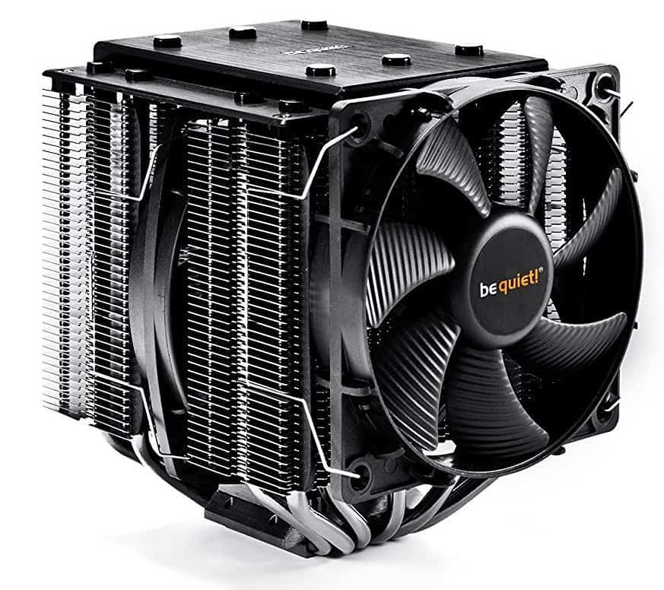
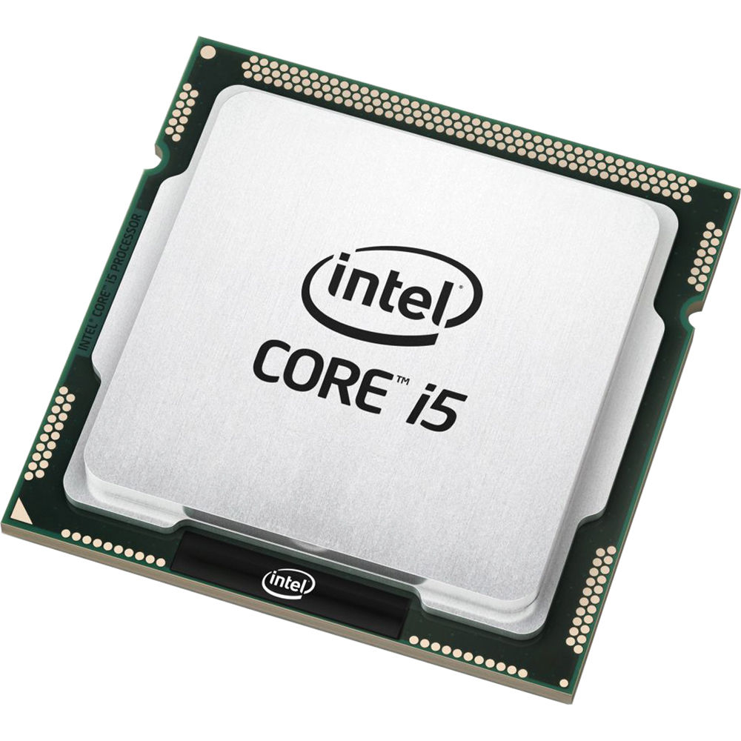
Thermodynamically – A CPU is just a Space Heater
CPU Chip
CPU Cooler

Slide 15
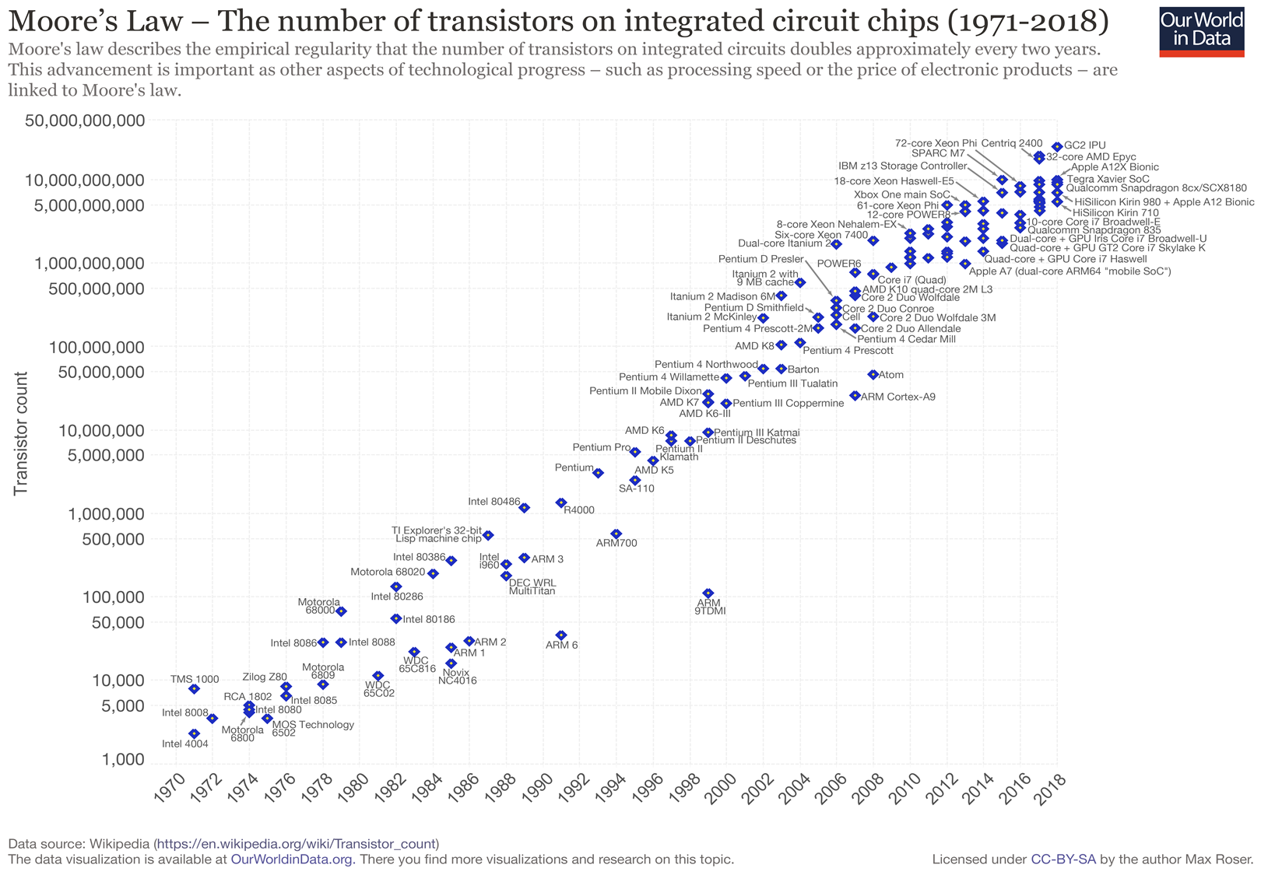
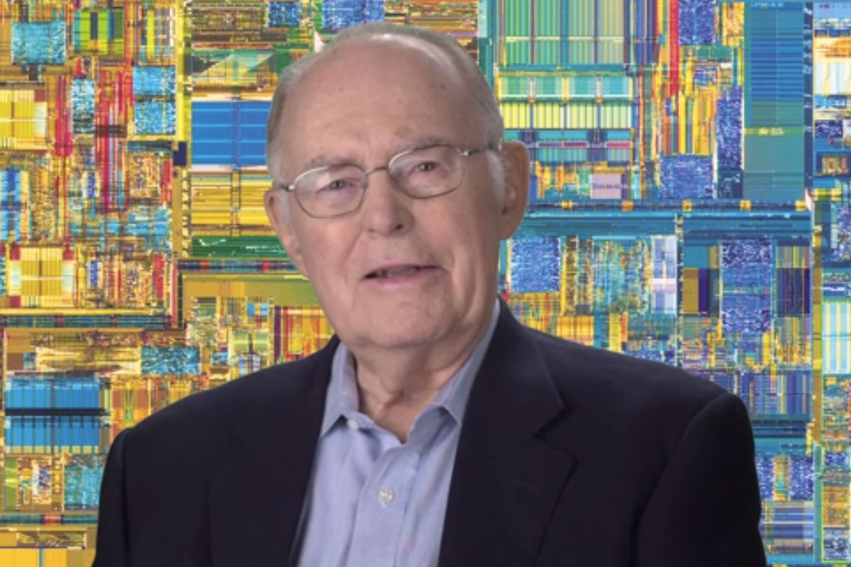
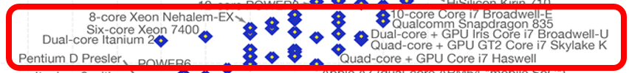
iPhone XS has > 6.9 Billion
Gordon Moore
Notes:
Click on http://www.singularity.com/charts/page61.html and look at 61 and 62
Chart from https://ourworldindata.org/technological-progress

Slide 16
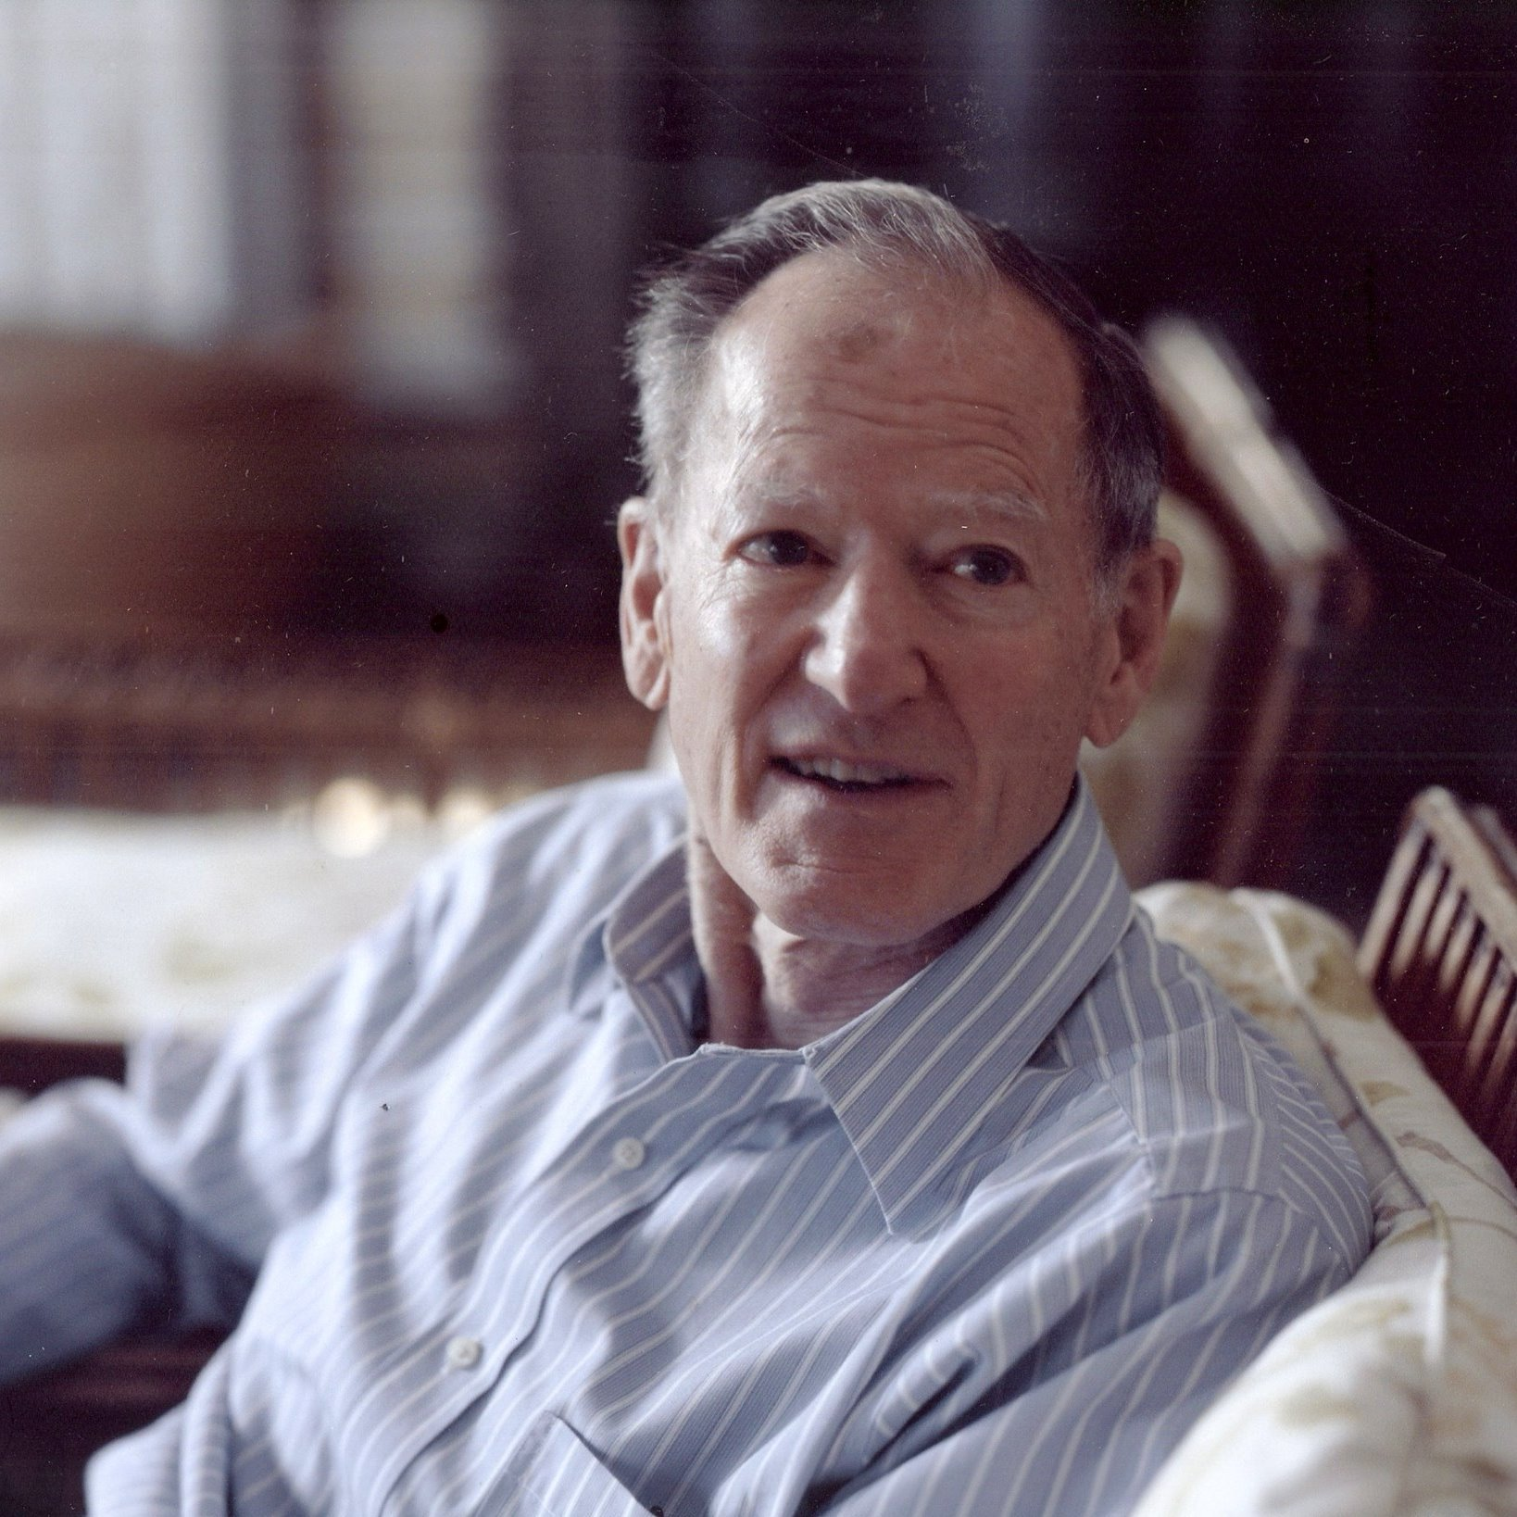
Principle of the Microcosm - George Gilder 1989
As transistors get smaller and more are packed onto a chip:
Logic costs less
It works faster
It works more reliably
It gets more done

Slide 17
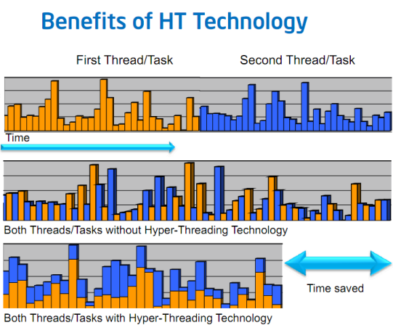
Threading Time-Slicing Multiple Cores Hyperthreading
What do you really need to know here?
A single core (processor) can only process one thing at a time, no matter how you slice it. So, more cores is better.
Multi-threading
Time slicing on one physical processor
Hyper-threading
One physical CPU core
Two logical (virtual cores) for one physical core
Clever scheduling of parts of thread across two logical cores
Only one thing can be done at a time (per physical core)

Slide 18
Demos
DoLotsOfMath.exe
FFMPEG Video Conversion

Slide 19

How to buy the fastest CPU???
CPU cores
CPU speed (plateaued at ~4Ghz due to energy loss)
Memory location, speed, and size
GPU cores, size and speed

Slide 20
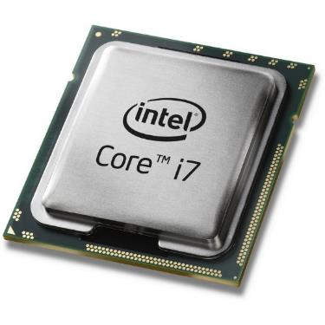
Memory Proximity to CPU
Cache (L1, L2, L3)
RAM
Hard Drive / Flash

Slide 21
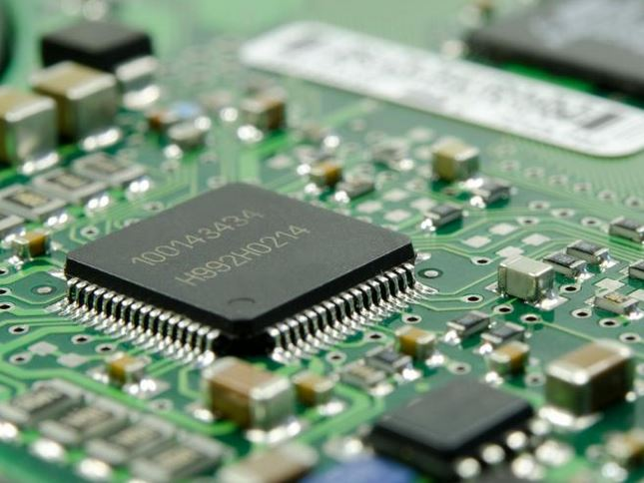
Primary Storage
Cache memory (~8MB)
Super fast memory
Low capacity
Part of the CPU
Volatile (erased when power is off)

Slide 22
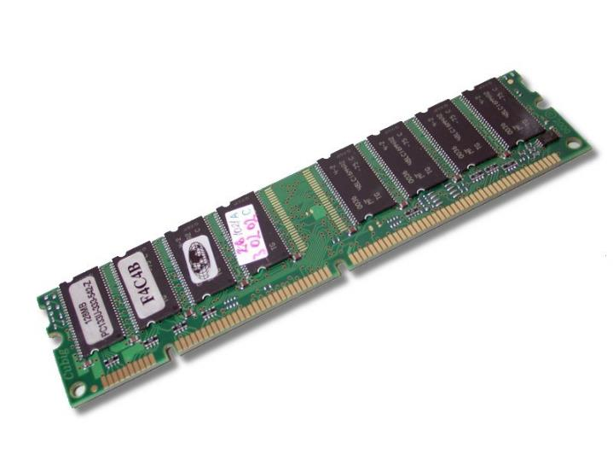
Primary Storage
Random access memory (RAM) (4-64 GB)
Medium Capacity
Medium Speed
Volatile (erased when power is off)

Slide 23
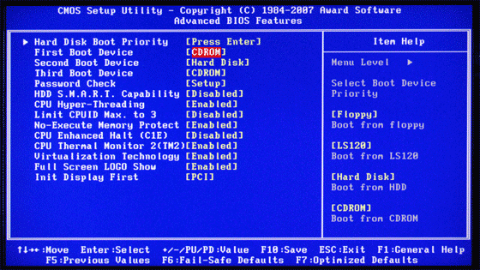
Primary Storage
Read only memory (ROM)
Holds BIOS -> Basic Input/Output System
Permanent, not lost when power turns off

Slide 24
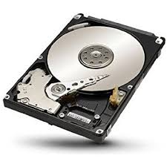
Secondary Storage
Magnetic Media
Hard drives (~ 500GB to 10TB)
Magnetic Tape (hardly used any more)
Floppy Disks (never used any more)
Slower, bigger, cheaper
Notes:
Solid state works using solid state transistors. 4 billion per gigabyte (i.e., 1 per two bits)

Slide 25
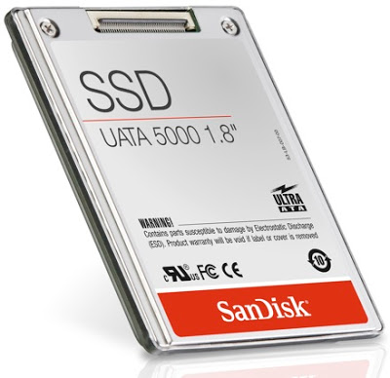
Secondary Storage
Flash
Solid State Drives (~ 128GB – 2TB) (generally faster)
USB sticks
Phones, smartphones, tablets
Smaller, faster, more expensive
Notes:
Solid state works using solid state transistors. 4 billion per gigabyte (i.e., 1 per two bits)

Slide 26
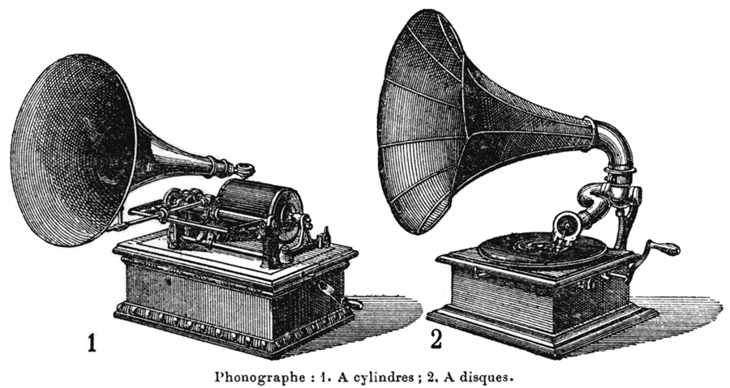
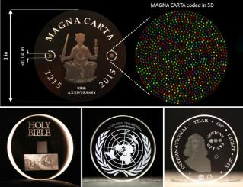
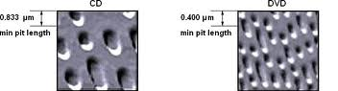
Secondary Storage
Optical
CDs (700MB)
DVDs (4.7GB, single-sided, 8.5GB, double-sided)
Blu-Ray (25GB, single-sided, 50GB, double-sided)
Click
Notes:
Solid state works using solid state transistors. 4 billion per gigabyte (i.e., 1 per two bits)

Slide 27
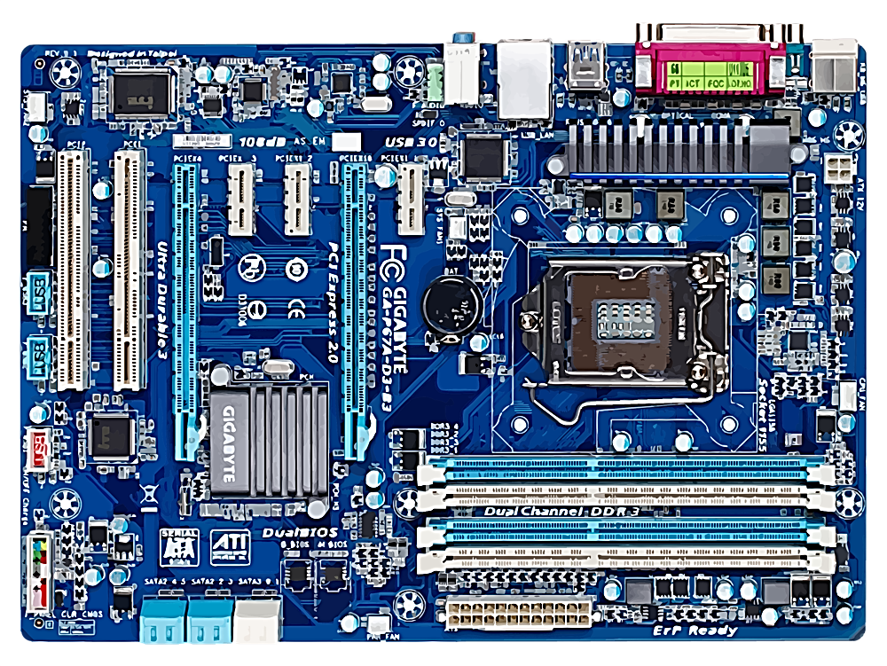
The Motherboard All the components live here (or at least they are connected to it)

Slide 28
Device Drivers
Demo
What are these?
Instruction sets to tell a device how to work and play nice with everything else
http://en.wikipedia.org/wiki/Device_driver
If a device is not working properly (printer, scanner, monitor, hard drive, DVD/Blu-ray drive, USB ports, etc), it is probably because of a driver issue

Slide 29
Stretch Break
Networking is coming up

Slide 30

Traffic on the “Information Superhighway” is Super
http://gaskination.com/ticker
http://www.worldometers.info/
http://www.internetlivestats.com/
http://wwwnui.akamai.com/gnet/globe/index.html

Slide 31
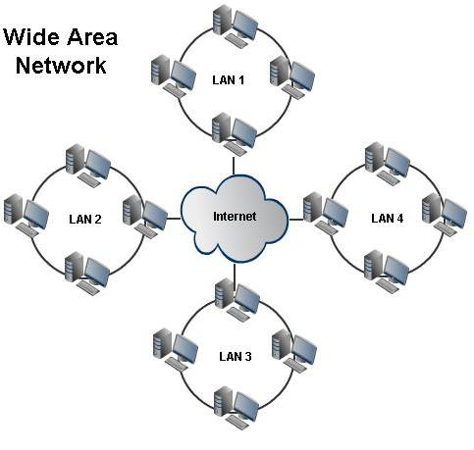
Network Basics
Wide Area
Network
LAN 1
Local area network (LAN)
Doesn’t require Internet
Internet
LAN 2
LAN 4
Wide area network (WAN)
Uses Internet backbone to connect dispersed LANs
LAN 3
Routers

Slide 32
Network Architecture
Peer-to-peer (P2P) networks
All connected machines have access to all publicly available files on every machine
Illegal Torrent stuff
Dropbox – sometimes
Skype
Client/server network (how most things online work)
Allows a more powerful server to handle and/or centralize processing. Each client has access only to the public files on the server.
Network operating systems (NOS) facilitates the client server architecture.

Slide 33
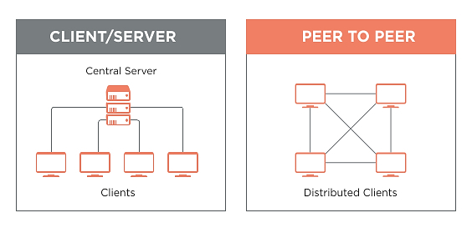

Slide 34
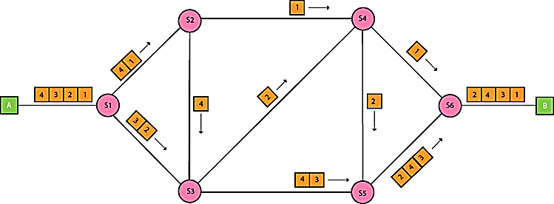
Packet Switching
How data transmission happens over a network based on dividing data into packets and sending them to routers

Slide 35
Network Protocols
A protocol is a standard that specifies the format of data and rules for transmission
Transmission Control Protocol/Internet Protocol (TCP/IP)
Provides the foundation standards for the Internet and many private LANs
TCP provides transport functions—ensuring the amount of data sent is the same as that received
IP provides the addressing and routing standards (i.e. the postmaster)
Play with Ping
Start, cmd, ping www.google.com
Play with Tracert (Trace Route)
Demo

Slide 36
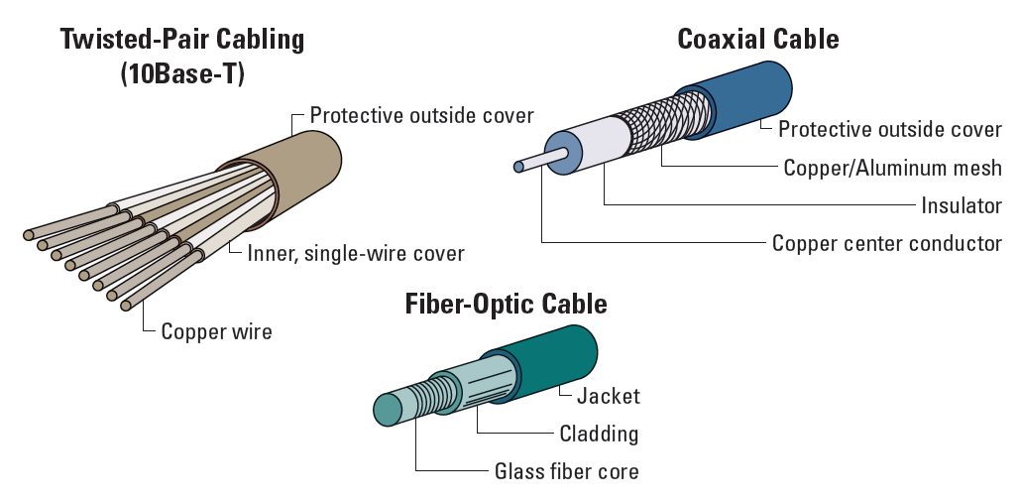
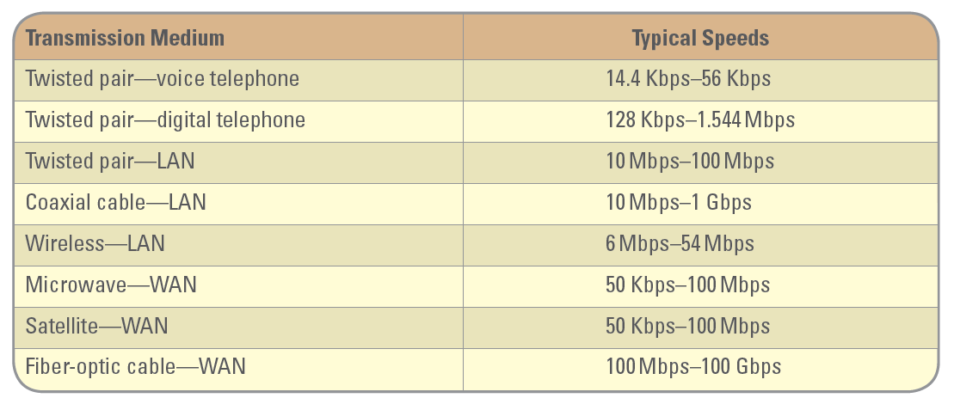
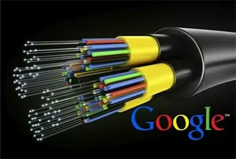
Communication Media
Twisted pair
Coaxial cable
Fiber-optic cable
Speedtest.net
Click
Notes:
Photons travel through fiber

Slide 37
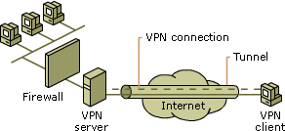
Using Networks for Business
Virtual private networks (VPN)
Organization data and resources
Remote User
Notes:
Overcome government censorship with vpn or ip cloaking

Slide 38
Network Speed
A misnomer: all electronic networks operate at the speed of light.
Latency
The amount of time it takes data to get through all of the routers between source and destination.
The sum of all the propagation delays.
Bandwidth
How much data can get through during an interval of time.

Slide 39
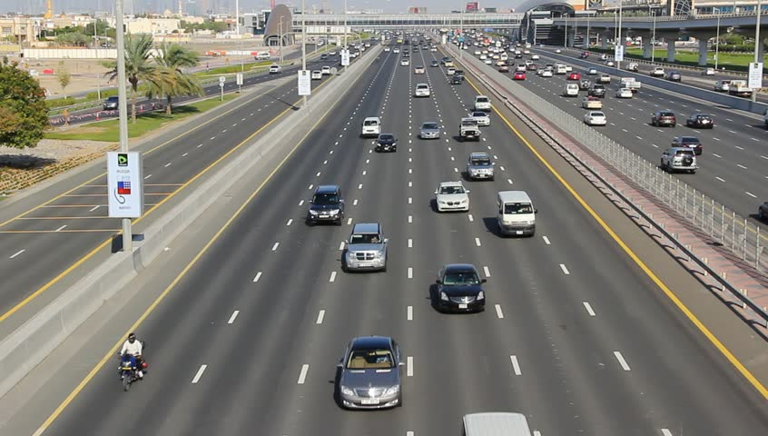

Slide 40
Bandwidth Demand (without data compression)
HD Television
1920 × 1080 pixels × 24 bits per pixel × 30 frames-per-second = 1,492,992,000 bps approx. 1.5 Gbps (using 1000s) or 1.4 Gbps (using 1024s)
CD Audio
44,100 samples/second × 16 bits/sample x 2 channels = 1,411,200 bps approx. 1.4 Mbps or 1.3 Mbps
A 700 MB CD can hold 69 minutes of uncompressed audio.

Slide 41
Data Compression
High quality MP3 Audio
320 Kbps vs. 1.3 Mbps: 75% Compression
High quality MP4 Video
6 Mbps vs. 1.4 Gbps: 99.5% compression

Slide 42
Optional Homework
Look up the most inspring things you’ve observed in Information Systems, Information Technology, the Internet, Computers, etc. Post them on Digital Dialog.

